Slide 1

Tata Steel – Tata iQ
Analytics Capability Building
10 / 11 / 2016
The information contained in the document is proprietary to Tata Industries Limited- Tata Insights & Quants Division and is strictly confidential. In consideration of receipt of this document, the recipient agrees that the information is being shared only for the limited purpose. The recipient of this information further agrees to maintain such information in confidence and to not reproduce, disclose, duplicate, electronically transmit or use in whole or in part for any other purpose. Prior written consent shall be obtained from the Insights & Quants Division of Tata Industries in case the information is necessitated to be shared with anyone other than the Recipient to whom this information is addressed. The above restriction shall not limit the right to use the information contained in this deck, if it is obtained from another source without restriction.
© Copyright, Tata Insights & Quants Division, Tata Industries Limited

Slide 2
The analytic journey in delivering business benefits
The analytic journey towards increased sophistication requires a set of diverse tools and talent to leverage the power of diverse data sources
Leveraging multiple data sources
…..to deliver insights, prediction and optimized strategies
Visualization
Visualization
Biz Analysis
Prediction
Simulation
Optimization
Tableau, D3…
R, SAS, Python, Angoss, MatLab…
Big Data Platform
Confidential Property of Tata Industries Ltd – Tata Insights & Quants Division

Slide 3





Tools will not deliver ROI unless
supported by the right people and the right data
Selection of the right tool is critical
…..but getting the right data and having the right people is more critical
Right People
Right Data
Right Methodology
Right Tool
The tool is just one piece in the journey to business impact
Confidential Property of Tata Industries Ltd – Tata Insights & Quants Division

Slide 4
14
Tata Steel and Tata iQ – the partnership model
Tata Steel Analytics COE – consisting of members of Tata Steel team and dedicated Tata iQ team
Other partners - tech
Customers - plant
KM
Repeatable Success
COE
Customers - marketing
Innovation
Tata Steel Seed Team
Tata iQ Seed Team
Tata iQ ad-hoc project team
Efficiency
Training
Customers – supply chain
Relationships
Technology
Customers – HR/Fin
Recruitment
Other partners – specialised services
Build the analytics COE, deliver quick impact projects, partner in creating POCs that are experimental in nature. And help manage peak loads when required.

Slide 5
Analytics @ Tata Steel – a semi outsider view
Analytics Centre of Excellence
Operating Business Units
Partners
Depth
Expertise
Users
Evangelists
Analytics aware
Build Expertise
Co-learn
Co-create

Slide 6
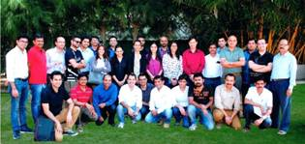
Tata iQ - about us
Tata iQ in the list of Analytics India Magazine’s (AIM) Top 10 most desirable Analytics Indian Firms to work for in 2016!
AIM charters this list every year based on a thorough research conducted in the analytics community and lists 10 most popular and talked about analytics providers from India.

Slide 7

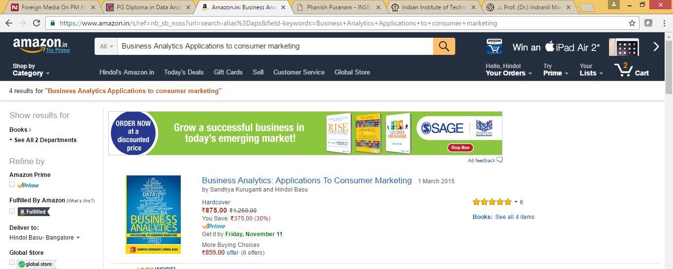



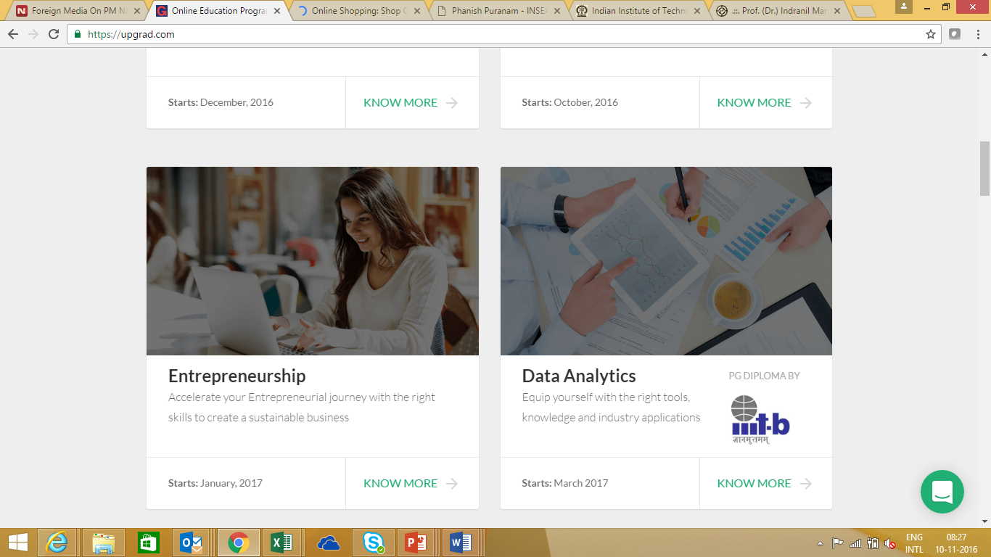


Tata iQ as Training Partner
Academic Partnerships
Analytics @ Tata Group
Current Knowledge Partnerships
Advisory Board
One of the topmost selling analytics reference books in India
Pradeep K. Chintagunta
University of Chicago
Understanding of analytics challenges within the Group
Knowledge of change management requirement
Appreciation of the unique challenge of “communicating analytics”
Experience of in benefit assessment and adopting a test & learn approach
Pulak Ghosh
IIM, Bangalore
Gah-Yi Vahn
London Business School
Phanish Puranam
INSEAD
Tata iQ members are faculty of the IIITB program in analytics
IIT Kharagpur – Metallurgical and Materials Engineering Department
https://upgrad.com/programs/data-analytics/
IIT Kanpur

Slide 8
Stakeholders & Objectives - analytics training within the context of Tata Steel
Stakeholders
Objectives
Common Risks
Develop analytics talent for CoE
Develop analytics talent for Business Units
Certified expertise : Uniform Certification Process across the organization
Uniform definition of capabilities
Develop uniform Skill Matrix for the organization : Lingua Franca for all analytics discussions
People perspective : individual growth & personal Value add
Delivering & tracking value through ROI assessment
Lack of contextualization
Lack of interactiveness
Lack of collective learning
Lack of Application orientation
Lack of Balance between organization and individual learning objectives
Lack of focus on value assessment of analytics
Lack of focus on implementation & change management
1
Employees
2
ACoE
Expertise, Usage, Evangelism, Awareness
3
Operating BU’s
4
Partners
Communicating Analytics : Essence of all Trainings

Slide 9

Training Overview
Components
Conduits
Stakeholders : Trainees
Theoretical underpinnings
Business Perspective
Hands on expertise
Communicating analytics
Quantifying value of analytics
Change Management and implementation
Classroom
Group Problem Solving
Field Applications
Quizzes
Assessment
Gamification
Business unit employees
ACOE resources
Analytics champions
Analytics users
Course Overview
Course-1: Introduction to analytics and data mining
Course-2: Forecasting, Optimization and Simulation
Course-3: Introduction to big data and unstructured data analytics (image, text, satellite image, speech, video etc.)
Course-4: Introduction to machine learning
Course-5: Analytics for specific business functions (marketing, HR, Finance)
Course-6: Advanced topics in big data and machine learning including deep learning and other similar emerging areas

Slide 10
Creating the Training Program
Academic Committee - to anchor all analytics training programs in the relevant business context in order to provide actionable learning.
Tata iQ Analytics SME - co-ordinator and lead
Tata iQ manager and senior analyst - creator of training content and facilitator of hands on training
Tata Steel analytics or automation expert – internal expertise for identification of Tata Steel examples & case studies
Tata Steel business expert – providing the Tata Steel specific business perspective & challenges. Helping in ROI assessment
Academic experts – bridging the overall knowledge gap

Slide 11

The Analytics Skill Matrix
The certification is tied to the expected role that will be taken up by an individual and will not always indicate a progression in analytics knowledge
Theory
Business Perspective
Hands-on Expertise
Communicating Analytics
Quantifying Value
Change Management & Implementation
L1: Analytics Aware
L2: Analytics Evangelist
L3: Analytics User
L4: Analytics Creator
L5: Analytics Expert

Slide 12
About Tata iQ
The information contained in the document is proprietary to Tata Industries Limited- Tata Insights & Quants Division and is strictly confidential. In consideration of receipt of this document, the recipient agrees that the information is being shared only for the limited purpose. The recipient of this information further agrees to maintain such information in confidence and to not reproduce, disclose, duplicate, electronically transmit or use in whole or in part for any other purpose. Prior written consent shall be obtained from the Insights & Quants Division of Tata Industries in case the information is necessitated to be shared with anyone other than the Recipient to whom this information is addressed. The above restriction shall not limit the right to use the information contained in this deck, if it is obtained from another source without restriction.
© Copyright, Tata Insights & Quants Division, Tata Industries Limited

Slide 13


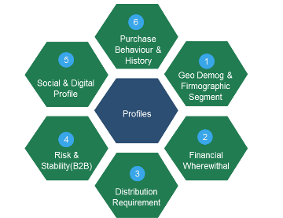

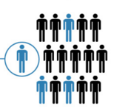











About Tata iQ
Our goal is to be India’s premier Omni-channel Marketing Solutions & Decision Sciences company powered by the richest and most valuable database, and high impact insights and analytics
Analytic Services
Largest and Richest Database
Collaboration and One Tata
Campaigns
Customer Insight &
Prospecting
Proprietary
Offline
Data
ShopsAPP
Risk Analytics
Public
Affiliate
Marketing
Online
Data
TSSS’15
Supply Chain
Operations
Group-wide Loyalty
Internal
Advanced Analytic Solutions
Tata iQ Proprietary Database
Building One Tata
Profiling, Segmentation, Predictive Analytics, Machine Learning
Quantitative Analytics, Existing Customer management (cross-sell, up-sell), Pricing, Channel, Store, Online, Assortment, Risk, Digital, Operations, Prospecting
900MM People Base
300 MM Enriched Base
Data across Individuals & Institutions
  Unified customer view, Maximize Revenue
  Minimize Expenses,
  Encompassing Loyalty mitigate risks, superior customer experience, sales/revenue growth
Confidential Property of Tata Industries Ltd – Tata Insights & Quants Division

Slide 14
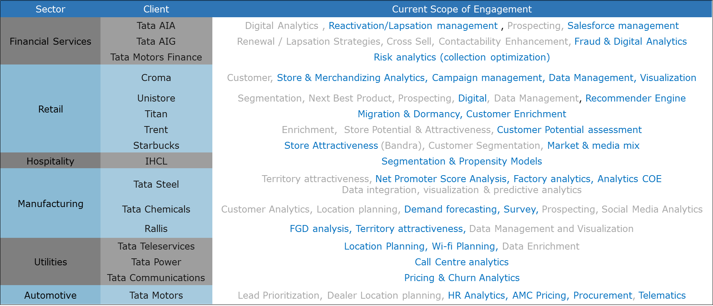
Summary of our Analytics Engagements
Active engagements with 16 Group companies across a diverse set of initiatives ranging from Customer, Operations, Pricing, Risk management, Digital, and Geo location based decision management.

Slide 15









Clusters
& Networks
Tata iQ is Creating the Richest and Most Valuable Database
Access to Strategic Sources
Superior Data & Analytics Capabilities
Tata iQ Attributes
Identifier Information
Tata iQ Proprietary Database
Advanced
Algorithms
Data
Mining
Proprietary
Logic
Purchase Behaviour
Data
Engineering
Internal Tata Co. Data
Location & Demographics
Public Database
Data
Insights
Data
Intelligence
Digital Persona
Big Data Management Expertise
Analytics to mine Customer Insights
Permissible access to leverage Group Co. Data
Big Data Capabilities to handle large data volumes
Associations, Clubs and Passions
Individuals, Households and Lineages
Tata Company Relationships
ON THE
BEDROCK OF
ISO 27001
Certification
Non-disclosure
Security
Purpose
& Consent
Confidential Property of Tata Industries Ltd – Tata Insights & Quants Division

Slide 16






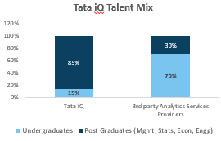






  Tata iQ is building a World Class Technology Solution
  with the Right Mix of Talent
TECHNOLOGY
TALENT
  NIMBLE
  Industry grade Hardware – Dell, Cisco,
  World Class data centre – Tata Communications
  Best of breed technology stack
Advisory Board
Hiring from
Premier Institutes
Pradeep K. Chintagunta
University of Chicago
Pulak Ghosh
IIM, Bangalore
  COST EFFICIENT
  Use of Big Data (Hadoop) Infra 1/5 Cost to traditional
  Mix of Open Source & industry grade tools.
  Best of breed tools
Gah-Yi Vahn
London Business School
Global Businesses
Superior Talent Mix
  SCALABLE
  Big data Infra Scalable to 100x capacity
  Flexible infra model with Tata Communications.
  Time to scale < 3 months.
Confidential Property of Tata Industries Ltd – Tata Insights & Quants Division

Slide 17
Thank You

